Slide 1

NFMT Quick Fire Presentation:
Solving Your Peace of Mind Problem
Presenter:
Cam Rogers
Director of International & Western US Sales

Slide 2
What is the right blend of airflow floor panels, temperature, humidity, airflow monitoring and leak detection products?
Every facility is unique!
Understand your concerns and threats…
Peace of mind is achieved by awareness!

Slide 3
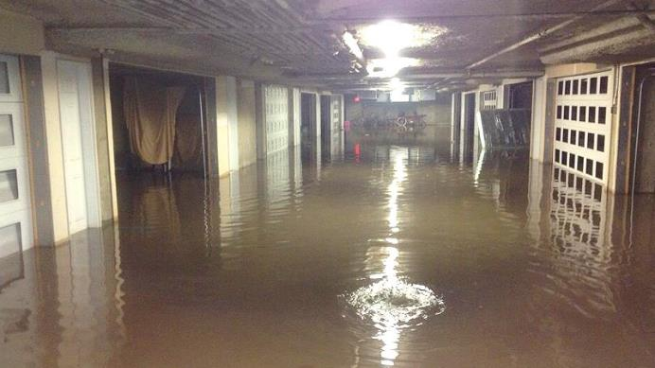
Reactive vs Proactive Monitoring

Slide 4

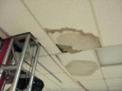


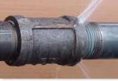
Sources of Leaks
Water Supply & Return Lines
  Pipes
  Couplings & Fittings
  Valves
Air Conditioning Units / Chillers
Plumbing Fixtures
Clogged Drains
Storage Tanks
Building Construction Issues

Slide 5
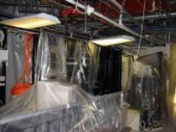
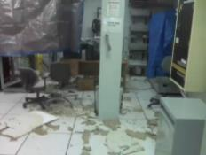
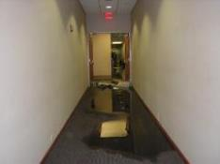
Identifying Threats
Has there ever been any leak related issues?
How were the issues identified & resolved? Was there any damage or downtime?
What damage could an unidentified leak cause?
Are reliable leak detection products already installed? Is it the most effective solution?
Is your insurance company offering incentives for having leak detection products installed?
Where are all of the potential sources of leaks?

Slide 6




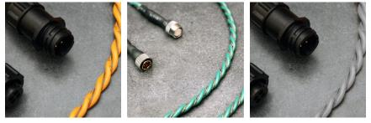
Spot Detectors & Sensing Cable
Spot Detectors are used to detect conductive fluids in confined areas
Sensing Cable is used to encapsulate sources of leaks or critical equipment that might be damaged by a leak

Slide 7

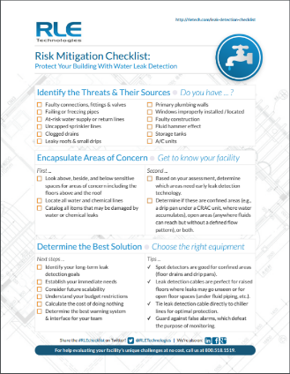
Leak Risk Mitigation Checklist
(Available on RLETech.com for download)

Slide 8
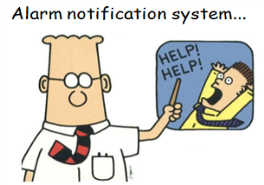
Site Monitoring Best Practices
Identify issues before they become critical
Issues usually start small and can snowball to a larger issue quickly
Localized summary alarms are only effective if someone is there to hear them
Alarms need to be sent to the appropriate people

Slide 9

Alarm Monitoring & Notification
Are all available sensors and alarm signals integrated into an alarm notification system?
  Is the system scalable?
  Are alarms routed to the right people?
  Can the current system provide visibility to numerous locations without the need for any additional software
  Are there recurring costs for the current system?
Can the current system easily accommodate 3rd party sensors?
Are there other conditions that should be monitored to help prevent downtime?

Slide 10

The Wireless Option
Would it make the most sense to use a wireless system to help reduce wiring and Installation costs?
Are there areas that require sensors that may be difficult to run wiring to?
Is a wireless system required that has the ability to integrate into a management system with SNMP, Modbus or BACnet protocols?

Slide 11









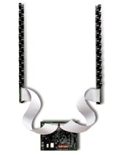
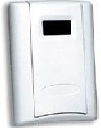

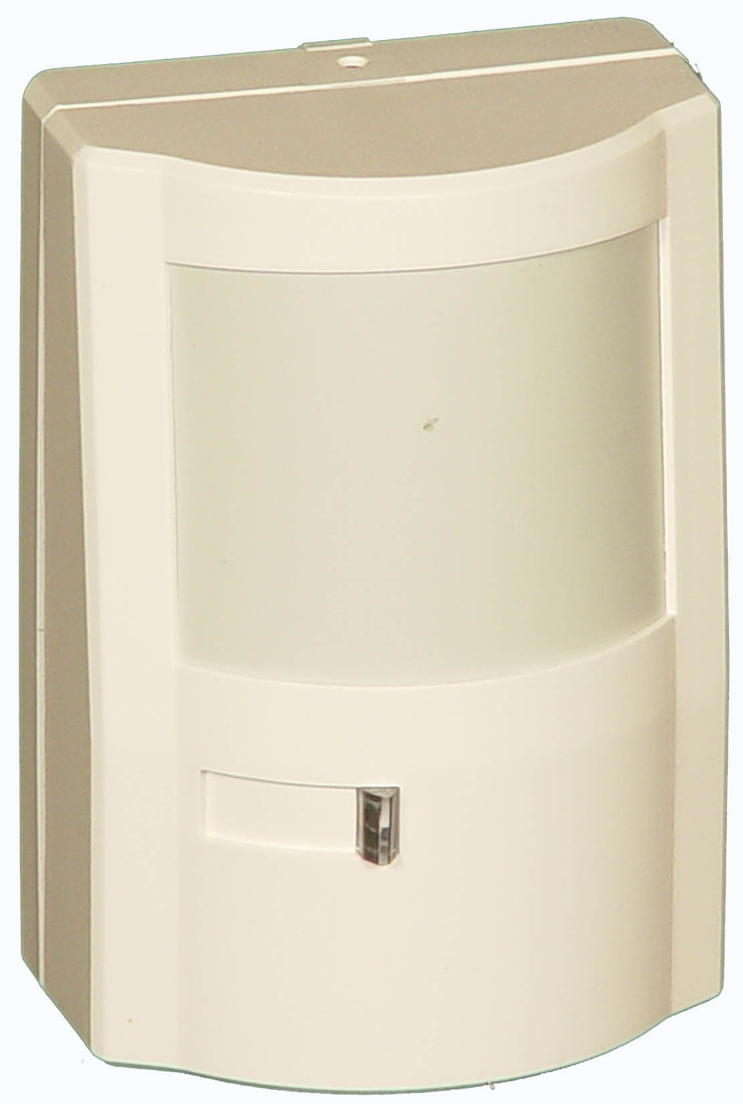
Site Monitoring Best Practices
Integrate all existing equipment and sensors
Summary alarm outputs are available from most critical equipment
Intelligent protocols provide substantially more information
If no integration capabilities are available, get creative and add appropriate sensors
Identify what can be added for comprehensive site monitoring

Slide 12

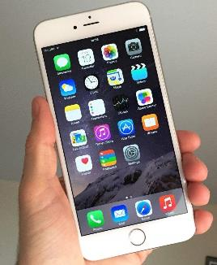
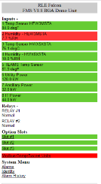

Benefits of a Web Interface
or
All inputs
Only inputs in alarm

Slide 13
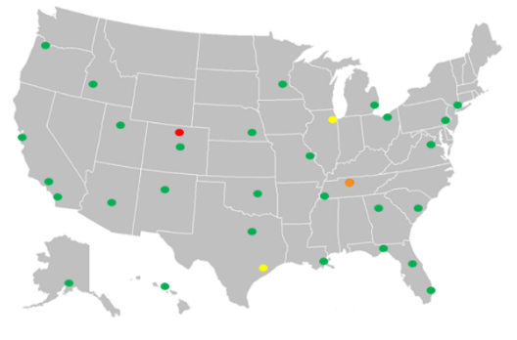
Benefits of a Web Interface

Slide 14
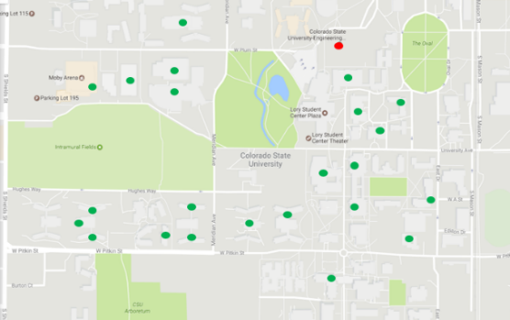
Benefits of a Web Interface

Slide 15
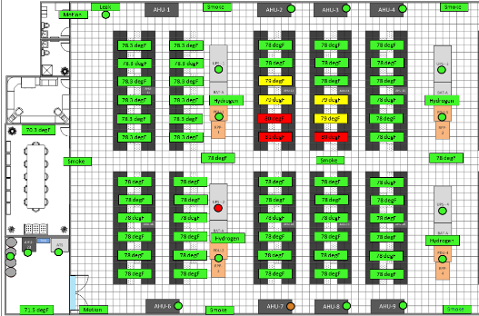
Benefits of a Web Interface

Slide 16
Raised Floor Perforated Panels Do Matter
Why should customers care about which perforated tiles they choose?
According to EMC…
“Cooling alone can account for 60 to 70 percent of data center power costs.”*
A well-designed airflow system can reduce the need for CRAC/CRAH energy by up to 50% and lower the upper server inlet temperatures by 10 to 20 degrees F
* http://www.telehouse.com/2017/01/robots-enter-the-data-center/

Slide 17

Site Monitoring Systems - Worksheet
Selection Worksheet
(Available on RLETech.com for download)

Slide 18

Achieving Peace of Mind
You can’t manage what you can’t measure!
Aggregating information from sensors and equipment to a single-pane-of-glass view simplifies the management of available information.
Direct alarm notification eliminates the need for someone to be on site to hear or see alarms
It ensures that the right people are notified and aware of issues so action can be take to resolve those issues before they become critical.

Slide 19
Questions?

Slide 20
NFMT Quick Fire Presentation:
Solving Your Peace of Mind Problem
Presenter:
Cam Rogers
Director of International & Western US Sales crogers@rletech.com | Booth: 2135

