Slide 1
Transforming White Space Into a High-Performance, Energy Efficient Data Center
DCIM & Monitoring Solutions
Beyond Whitespace Seminar
April 27th, 2014
Presenter:
Cam Rogers
Director of International & Western US Sales

Slide 2
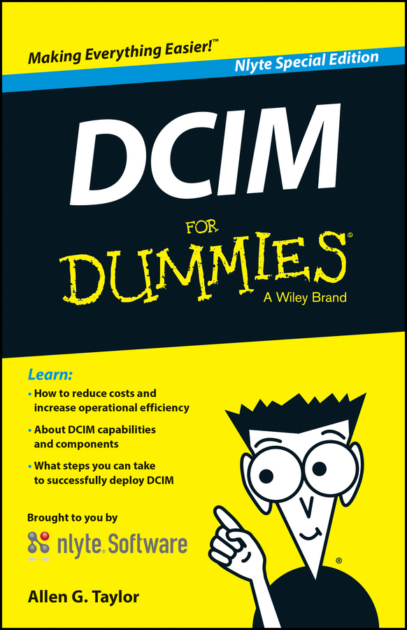
What is DCIM?
Data Center Infrastructure Management
It seems everyone has a slightly different definition.
Gartner defines DCIM as tools that “...monitor, measure, manage, and/or control data center utilization and energy consumption of all IT-related equipment… and facility infrastructure components...”¹
One DCIM software provider understood the confusion in the market, and proactively went so far as to publish a DCIM for Dummies book² to help explain the DCIM landscape to its potential customers.

Slide 3

DCIM Complexity
One international company purchased a monitoring solution from a leading DCIM provider, and then put out an RFQ for a DCIM system because they were unaware that the system they already had was fully capable of being used as a DCIM solution.
Another major national company purchased a DCIM solution almost two years ago, and has yet to implement it. It was too complex and their staff didn’t have time to “learn” how to use it – still relying on existing BMS.

Slide 4
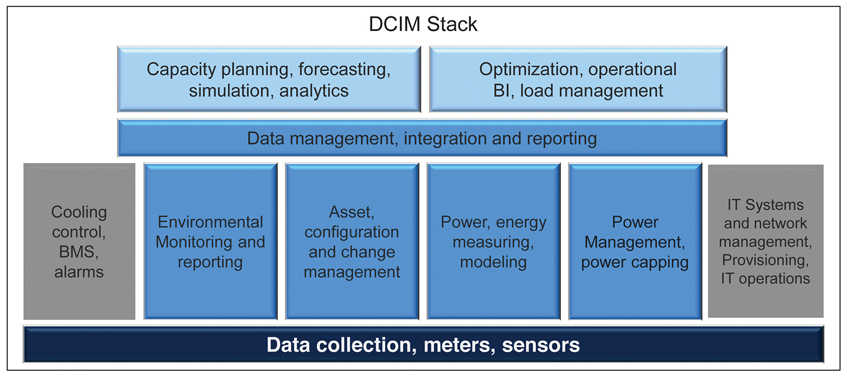
Infrastructure Analytics
DCIM, when deployed properly, enables real-time monitoring of, and data collection from, multiple disparate systems throughout the data center via multiple protocols.
This allows analysis of a wealth of data, including environmental conditions, power, CPU availability, space, asset tracking & management, and available capacity of various systems.

Slide 5

Key DCIM Drivers & Benefits
Increase operational efficiencies on both the IT and Facilities sides of the business to help reduce costs.
Extend the health and lifecycle of your data center
Better manage cooling and power through environmental and power monitoring.
DCIM solutions can be powerful tools that provide data center managers/operators with a wealth of information they would otherwise struggle to ascertain.

Slide 6
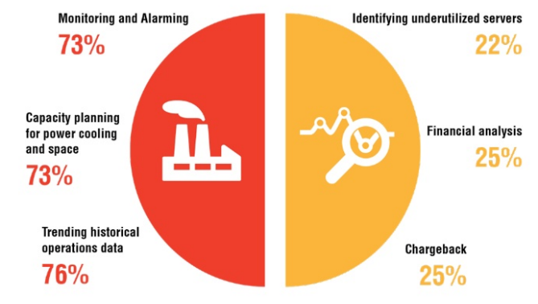
How do Data Centers Use DCIM?
According to the Uptime 2015 Data Center Industry Survey:

Slide 7
The Foundation of Every DCIM
“You can’t manage what you don’t measure.”

Slide 8
You can’t manage what you don’t monitor !

Slide 9
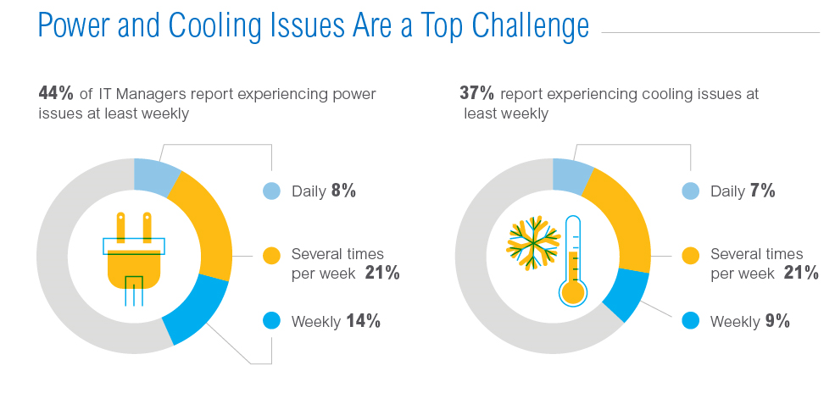
Site Monitoring Best Practices
Environmental and power monitoring can expose the underlying reasons for recurring problems.
http://www.intel.com/content/dam/www/public/us/en/images/diagrams/dcim-survey-infographic.jpg

Slide 10

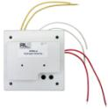
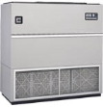






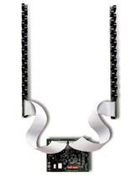
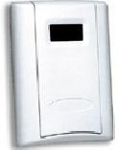
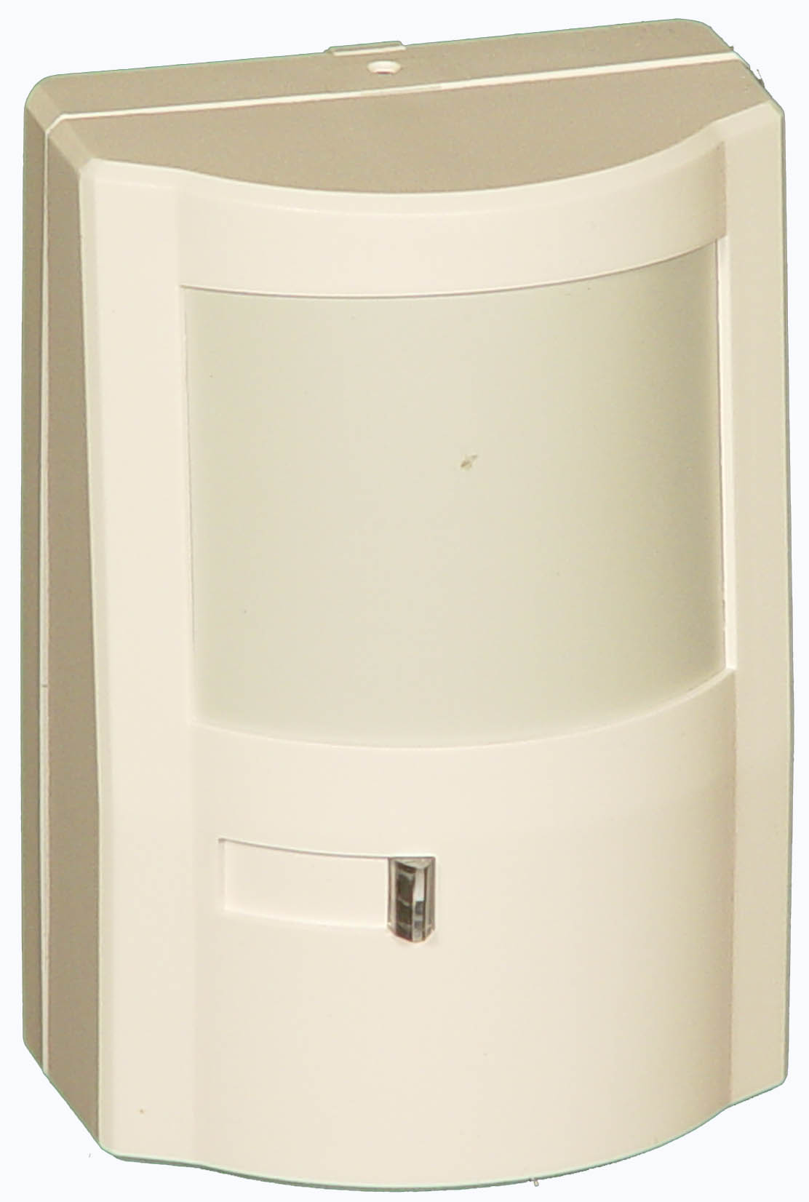

Site Monitoring Best Practices
Enterprise Sites
Integrate all existing equipment and sensors
  Summary alarms from critical equipment
  Intelligent protocols provide more information
  Get creative and add appropriate sensors as needed
  Make sure that alarms are routed to the right people
Identify what can be added for comprehensive site monitoring
Colocation Sites
Understand what information is available from your provider
You may have the ability to add additional sensors within your leased space

Slide 11
A Little About RLE Technologies…
We exist to prevent disasters, preserve our clients’ reputation and provide peace of mind.
Founded in 1984 – Raymond & Lae Engineering
Headquarters and manufacturing located in Fort Collins, CO
Most products are made in Colorado
A recognized international leader in the facilities monitoring and leak detection markets
Three product categories that include…

Slide 12

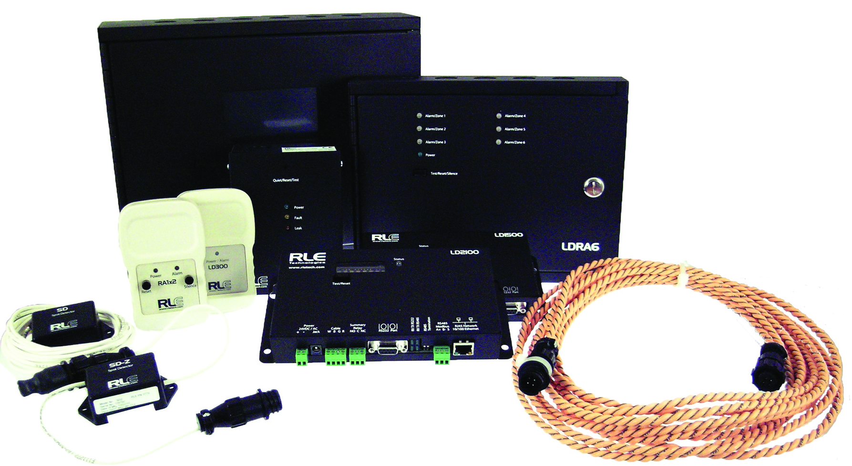
Leak Detection

Slide 13
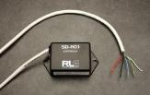
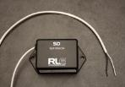
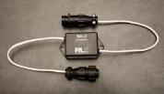
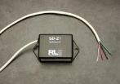


Spot Detectors & Sensing Cable
Spot Detectors are used to detect conductive fluids in confined areas
Sensing Cable is used to encapsulate sources of leaks or critical equipment that might be damaged by a leak
Conductive fluids
Chemicals & Acids

Slide 14

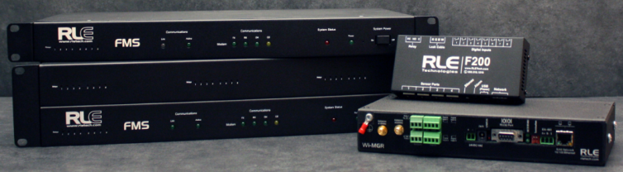
Alarm Monitoring & Notification Products

Slide 15
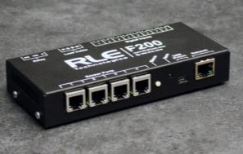

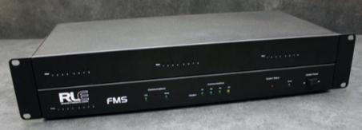
Falcon F200 & FMS
Falcon products are used to provide visibility to sensors and equipment at anytime, from anywhere and provide direct alarm notification when conditions exceed acceptable limits.
NO SOFTWARE REQUIRED
NO RECURRING COSTS
Configured and viewed with a web browser
Connect it to a network
Connect sensors and equipment
Establish acceptable limits
Identify who gets notified when conditions exceed acceptable limits
Pass critical information up to a management system through standard communication protocols. (SNMP | Modbus | BACnet)

Slide 16
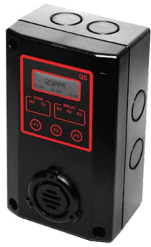
What Can Falcon Products Monitor?
Any device that provides any of the following output signals:
Dry Contact, 4-20mA, 0-5VDC & 0-10VDC…
Existing Equipment & Sensors including:
Temperature
Humidity
Water
Voltage
Amperage
Airflow
Smoke
Gas
Motion
Door
Light
Sound

Slide 17
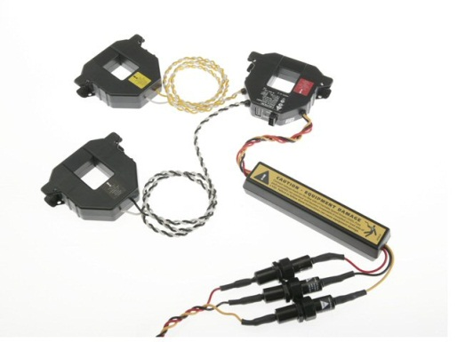
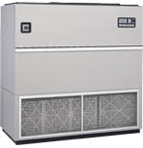

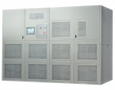

What Can Falcon Products Monitor?
Any device that provides any of the following output signals:
…SNMP, Modbus & BACnet
Existing Sensors & Equipment including:
Computer Room Air Conditioners (CRAC’s)
Power Distribution Units (PDU’s)
Power Meters
Uninterruptable Power Supplies (UPS’s)
Branch Circuit Monitors (BCM’s),
Automatic Transfer Switches (ATS’s)
Transient Voltage Surge Suppressors (TVSS’s)
IP Cameras
Generators
Fire Panels
Security Systems

Slide 18
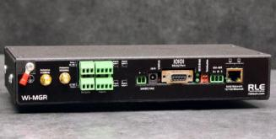




Wireless Sensor Network Manager
Simplify sensor deployment by eliminating the need to run sensor wiring
Allow sensors to be easily relocated when the needs arise
Designed to accommodate acceptable frequencies worldwide
Provides direct alarm notification when conditions exceed acceptable limits
Integrate with existing management system with SNMP, Modbus and BACnet protocols

Slide 19

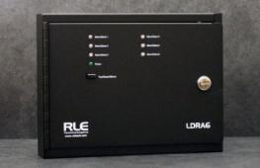
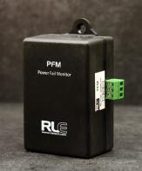
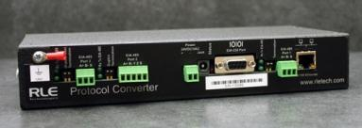
Integration Solutions

Slide 20


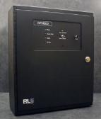

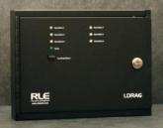

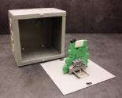

Raptor Integration Solutions
The Protocol Converter accepts SNMP, Modbus and BACnet signals from up to 32 devices and translates the signals to SNMP, Modbus and BACnet for integration.
Unique application may require specialty products

Slide 21

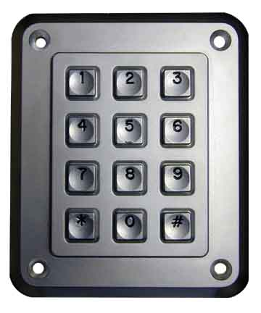
RLE Technologies – A Single Source
RLE Technologies has partnered with numerous other manufacturers to be able to provide a variety of sensors to completely protect critical facilities
Temperature
Humidity
Power / Amperage
Airflow
Smoke
Gas
Motion
Door

Slide 22
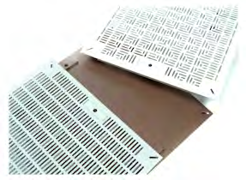
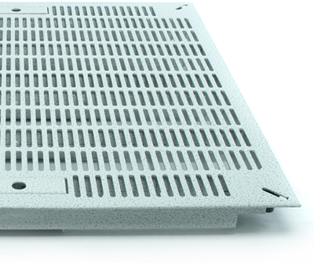


Introducing… Triad Raised Floors
Founded in 2003, multiple patents
Complete raised flooring systems available for data center and cleanroom environments
Airflow Panels are designed fit into any existing or new raised access floor system
  Integrated handles – easy to install/move
  Available with dampers to more precisely control airflow

Slide 23
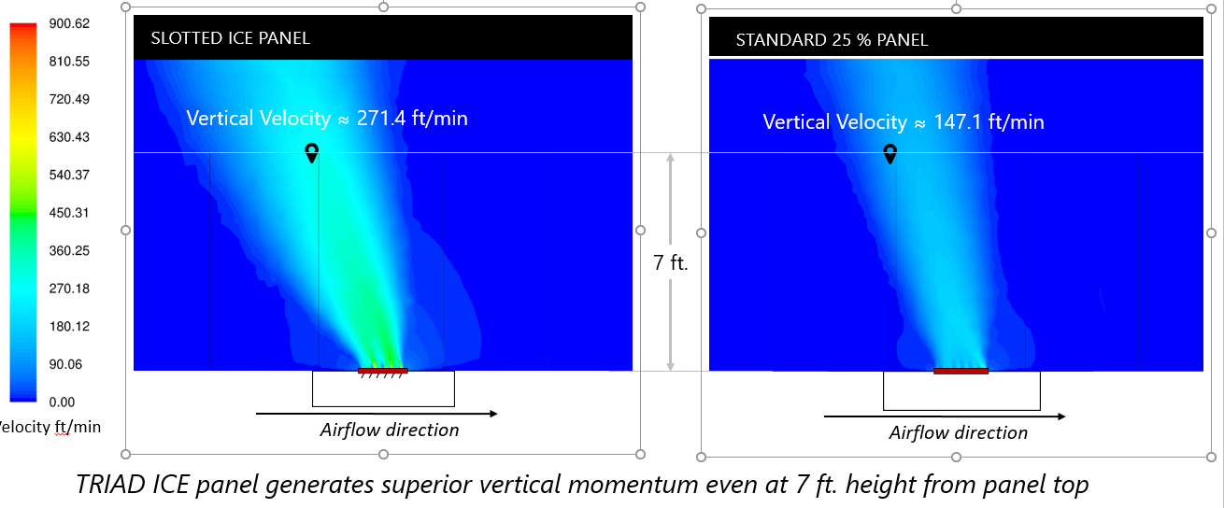
Triad Raised Floors
According to EMC, “cooling alone can account for 60 to 70 percent of data center power costs.” ³
A well-designed airflow system can:
reduce the need for CRAC/CRAH generated air by up to 50%
lower the upper server temperatures by 10 to 20 degrees.

Slide 24
In Conclusion…
“A journey of a thousand miles begins with a single step”
Does it make sense to manage your own white space or let someone else manage the white space for you?
Monitoring is the foundation of every DCIM
Integrate what you have and add what is needed
Identify what you would like to accomplish today and also what may be needed in the future
One size does not fit all!

Slide 25

Questions
Questions

Slide 26

Resources
rletech.com
  Product literature
    Datasheets
    Quick Start Guides
    User Guides
    Architect and Engineering Specifications
    Videos
  Live demos for IP based products are available on the specific product web page of our web site

Slide 27
Transforming White Space Into a High-Performance, Energy Efficient Data Center
DCIM & Monitoring Solutions
Beyond Whitespace Seminar
April 27th, 2014
THANK YOU!

Slide 28
References
http://www.gartner.com/it-glossary/data-center-infrastructure-management-dcim
http://www.nlyte.com/
http://www.telehouse.com/2017/01/robots-enter-the-data-center/

